Slide 1
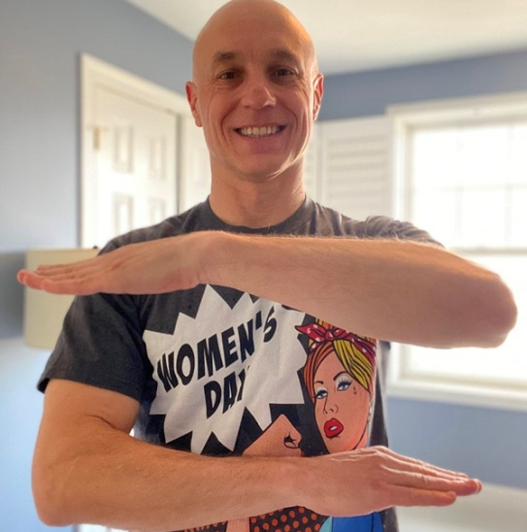
Philippe Signore Life Role: Dad Oblon Role: Managing Partner
Here is how I can support the 2020 IWD theme of #EACHFOREQUAL in my daily life:
Teach my 3-year-old daughter to never settle for less than equal
Thank my 85-year old mother for being a role model as a working single mom who raised two boys
Appreciate, respect and collaborate with Oblon’s female employees
Promote gender parity and equality at Oblon

Slide 2
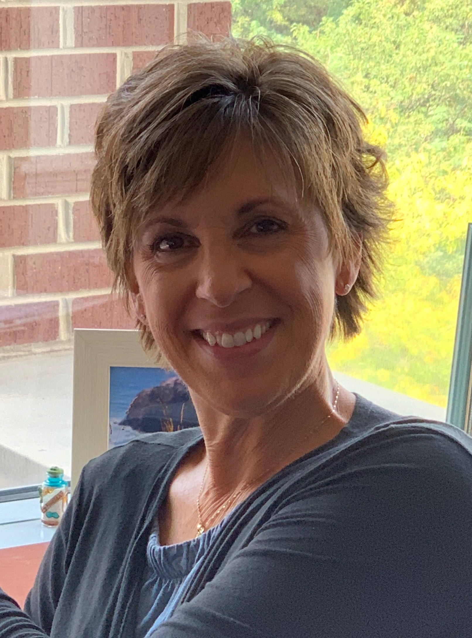
Andrea Camardella Life Roles: Mother, Daughter, Sister, Friend Oblon Role: Executive Assistant to the Managing Partner
Here is how I can support the 2020 IWD theme of #EACHFOREQUAL in my daily life:
Recognize, appreciate and acknowledge the strengths in all people (family, friends, and co-workers).
Everyone I meet has a story. Be more attentive to what that person is saying or better yet what they’re not saying
Encourage those who doubt themselves and who think ‘I can’t do that.’ Show them how to recognize the many gifts and talents they have in order to achieve the goals they have set for themselves.

Slide 3
Carla Askey Life Roles: Daughter-Wife-Mother-Future Grandmother Oblon Role: Director of Practice Support
Here is how I can support the 2020 IWD theme of #EACHFOREQUAL in my daily life:
Continue to model what has been important in MANY generations in my family (four shown here) – WORK HARD.
Continue to model for my daughter (and future granddaughter) that no matter what your gender, you can be anything you want to be – if you WORK HARD at it.
Did I say WORK HARD????

Slide 4
Eckhard Kuesters Oblon Role: Partner Life Role: Father
Here is how I can support the 2020 IWD theme of #EACHFOREQUAL in my daily life:
I have taught my three daughters my views on gender equality by living a life where my example speaks for itself. That example always included respecting individuals for who they were regardless of race or gender or religion, and expecting my daughters to act in the same way. My three daughters were expected to be honest, hardworking and self-sufficient. They have become wonderful role models for their own daughters. I am proud of their accomplishments and let them know that and how much I love and value them every day.

Slide 5
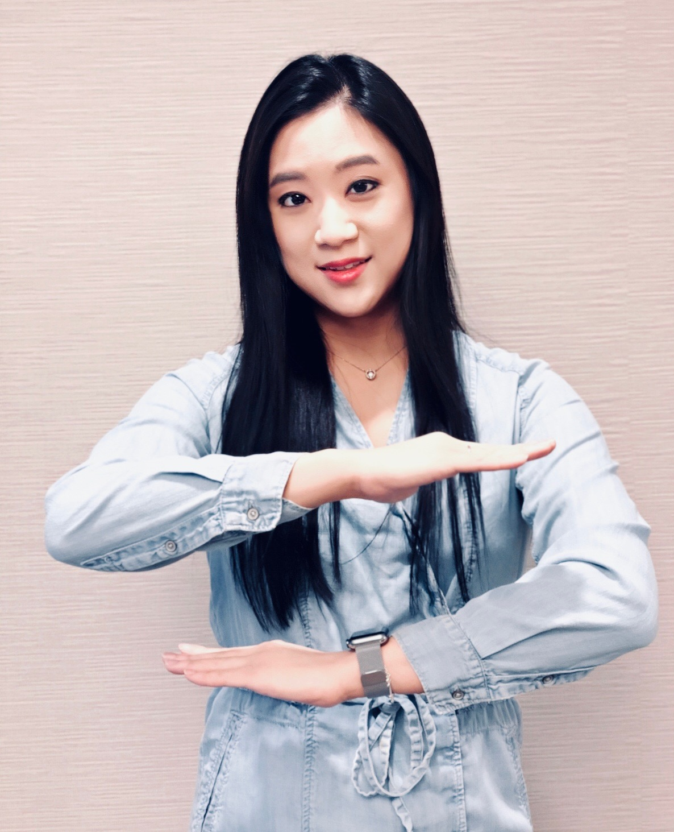
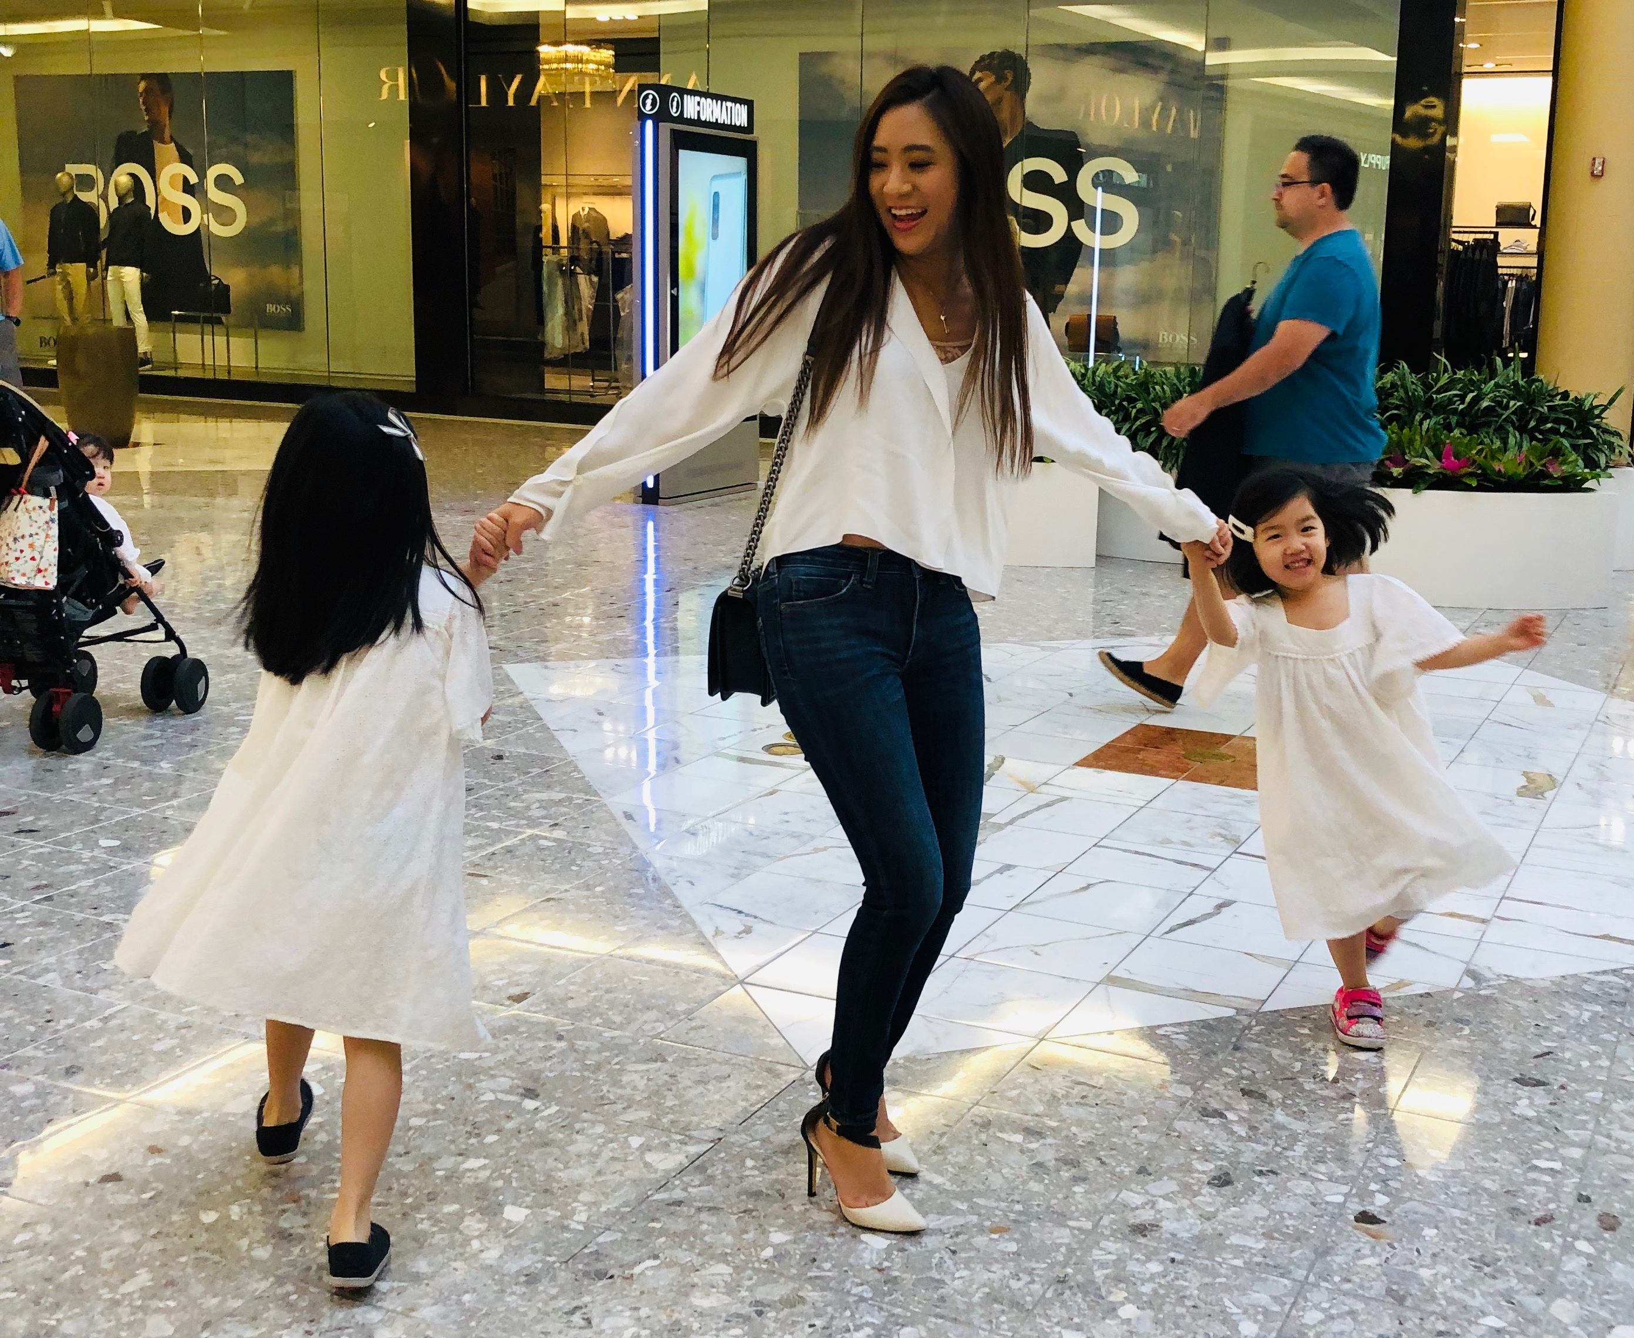
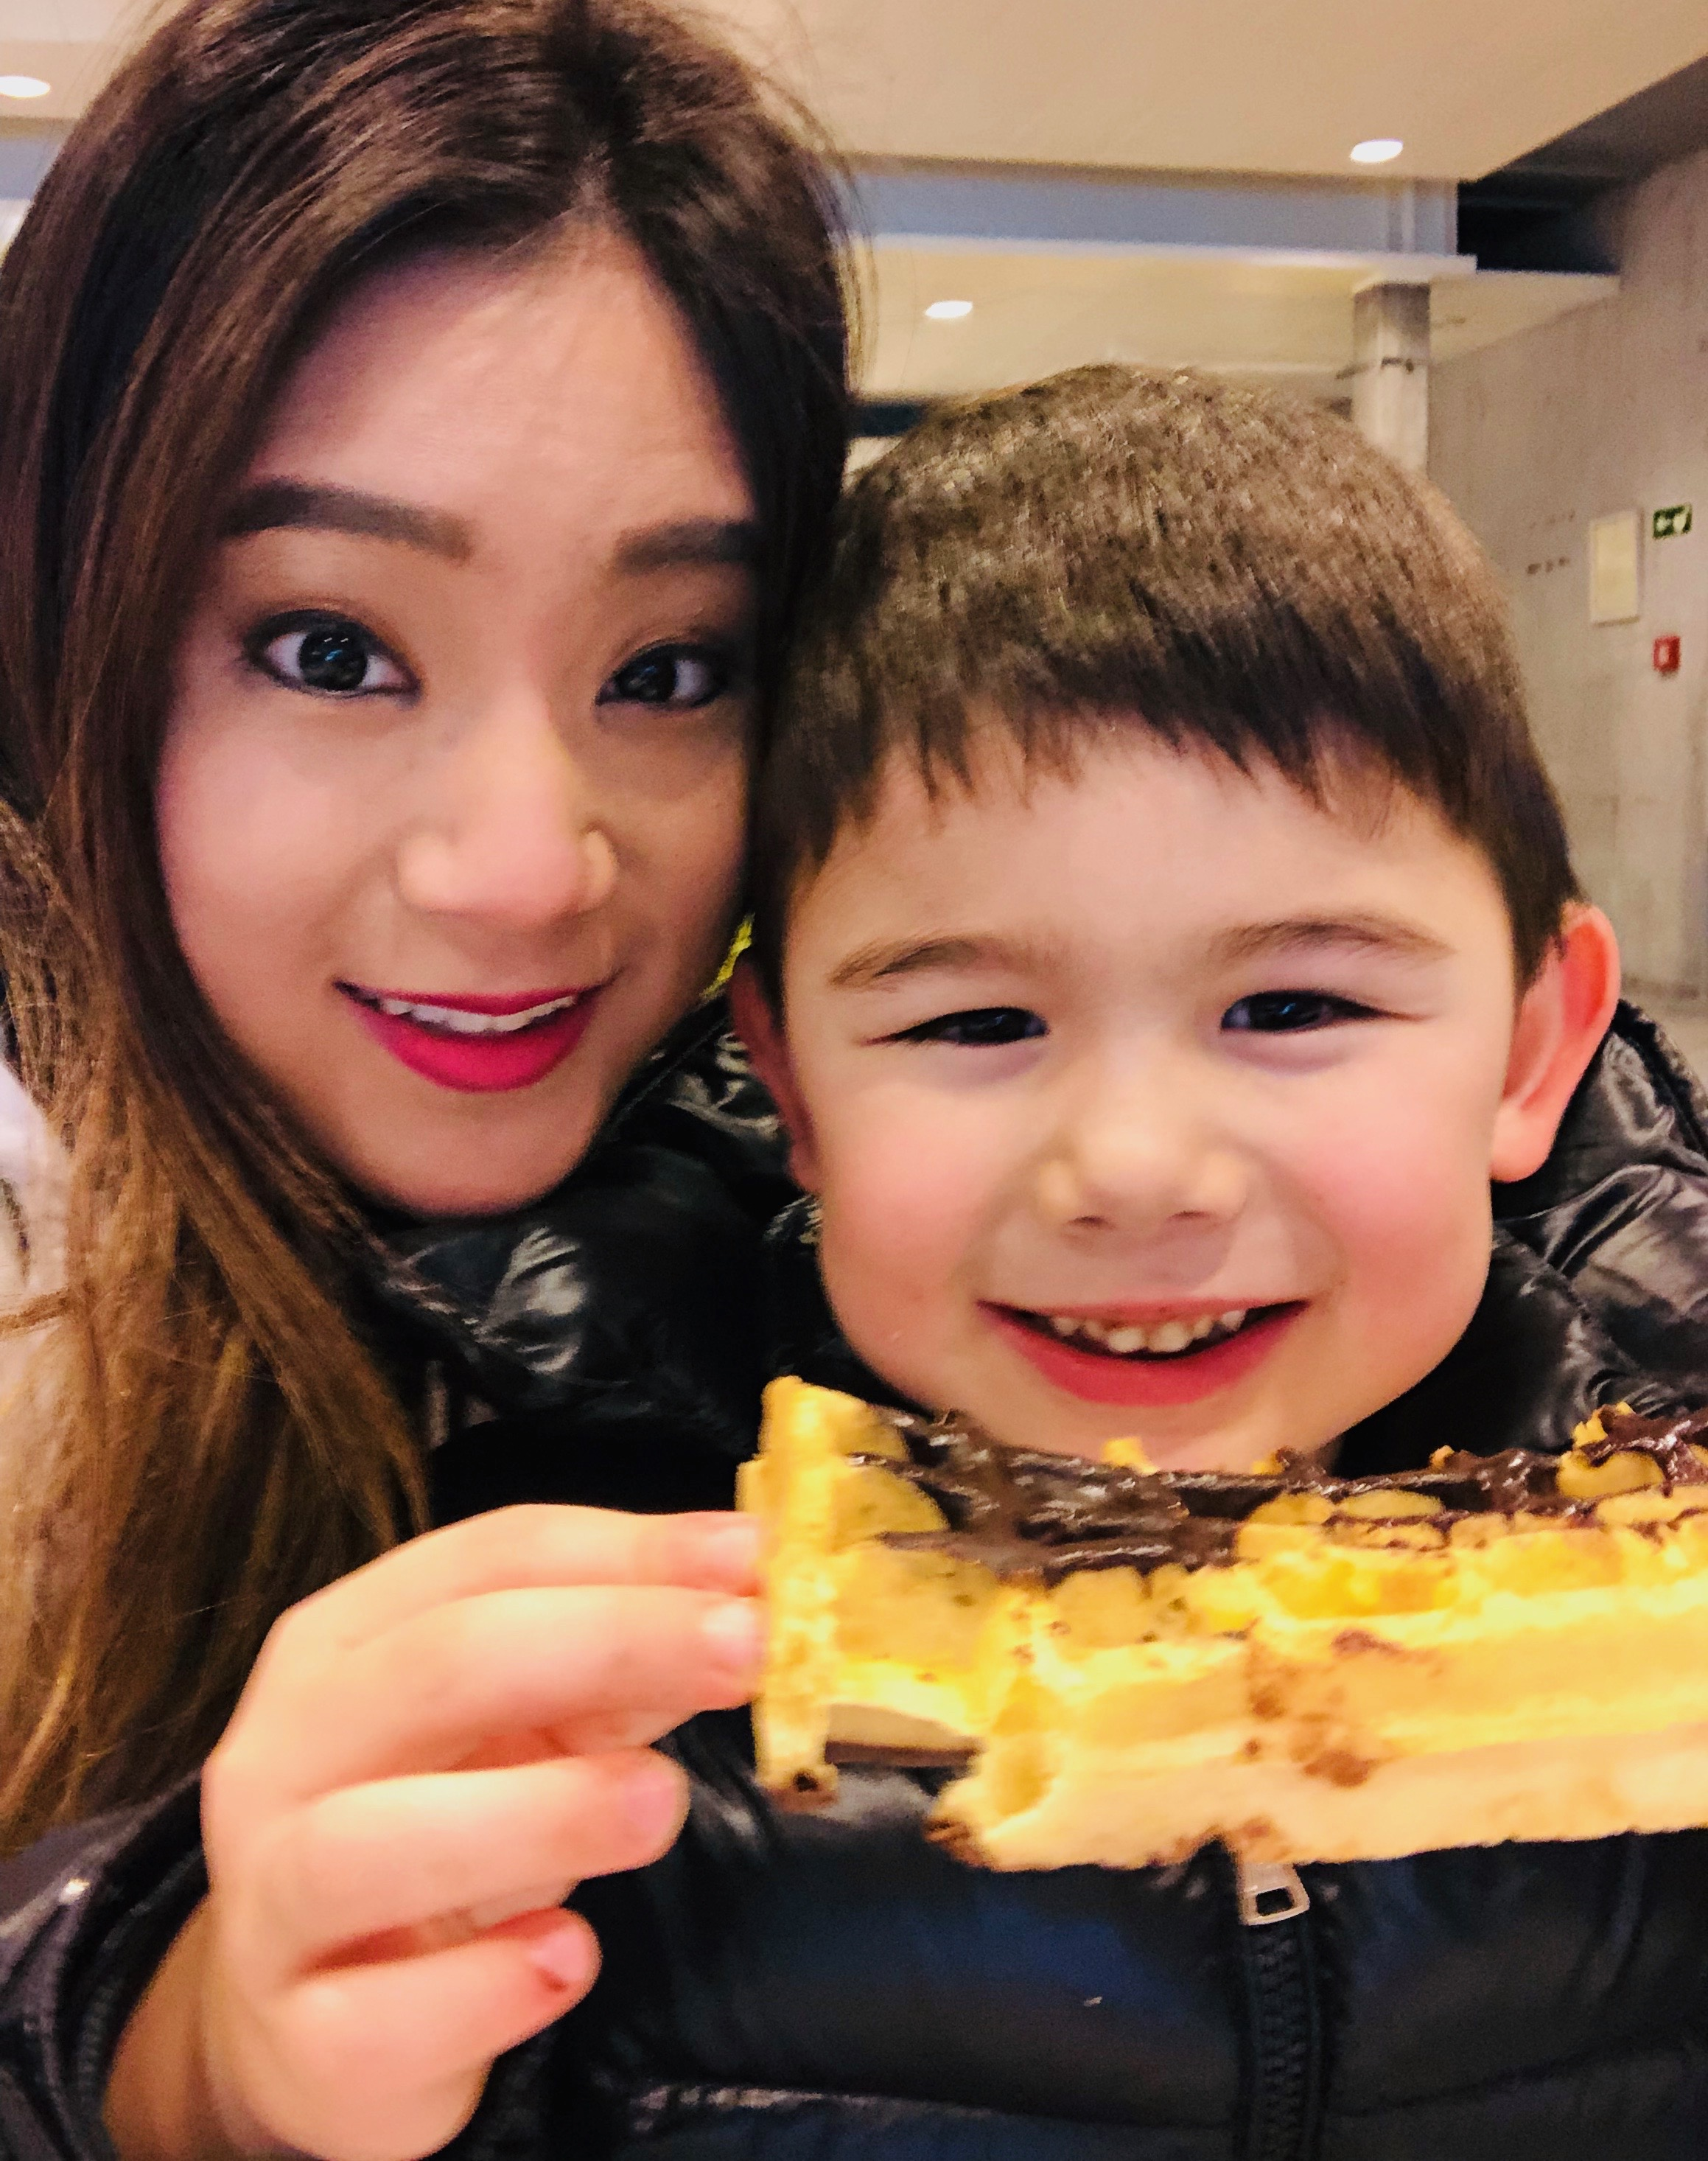
Grace Kim Life Roles: Daughter-Sister-Aunt Oblon Role: Senior Associate
Here is how I can support the 2020 IWD theme of #EACHFOREQUAL in my daily life:
Be mindful of unconscious bias;
Appreciate and empower others;
Trust my colleagues and friends to strive for #EachforEqual

Slide 6
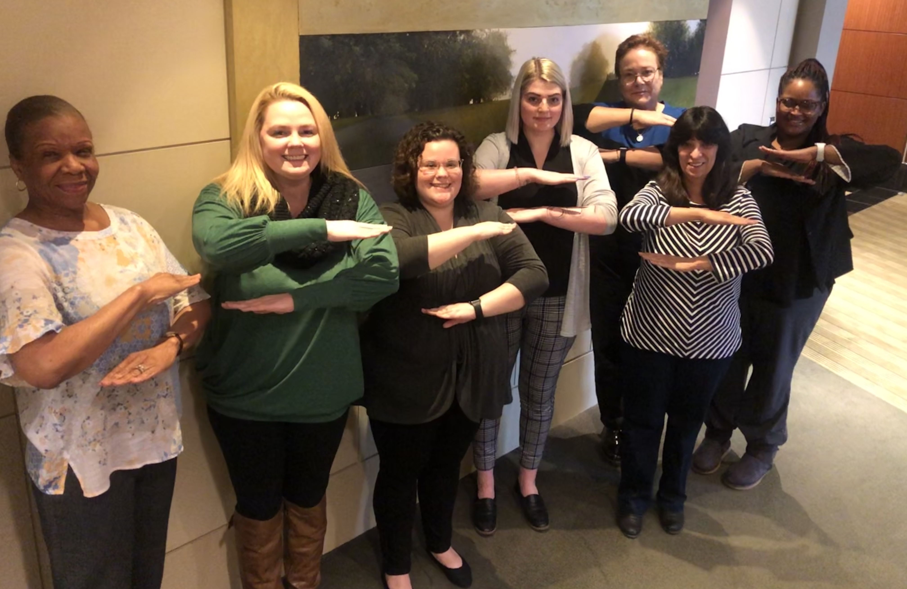
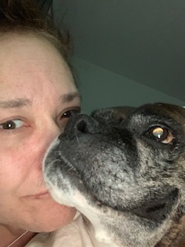
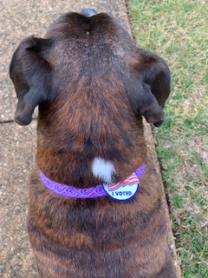
Karen Lamelle Life Roles: Aunt, Sister, Friend & “Boxer Mom” Oblon Role: Proud Member of Oblon HR
Here is how I can support the 2020 IWD theme of #EACHFOREQUAL in my daily life:
Act with intentional integrity;
Be mindful of inequities so as not to participate in their advancement;
Choose to be #EachforEqual

Slide 7
Lisa Mandrusiak Life Role: Mother Oblon Role: Senior Associate
Here is how I can support the 2020 IWD theme of #EACHFOREQUAL in my daily life:
I chose “Men Explain Things to Me” by Rebecca Solnit for my book club meeting, which includes several essays exploring how women operate under patriarchy. This sparked a lively discussion among the book club members and is a small way to spread awareness.
Educating my kids about gender equality on a daily basis
Donate money to non-profit organizations working with women. One of my favorites is Carry the Future, an organization supporting refugee families.

Slide 8
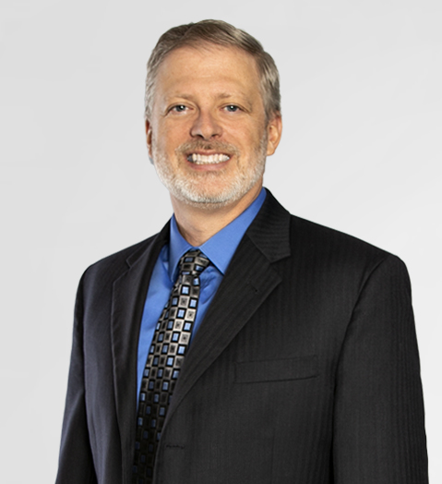
Michael Casey Life Roles: Father – Brother – Uncle Oblon Roles: Partner and Mentor
Here is how I can support the 2020 IWD theme of #EACHFOREQUAL in my daily life:
Mentor in a local Girls Who Code high school program to support future Women Engineers at an age where it helps to see that they can succeed in Science, Technology, Engineering and Math (STEM) programs
Raise son and daughters the same in a loving and supportive environment

Slide 9
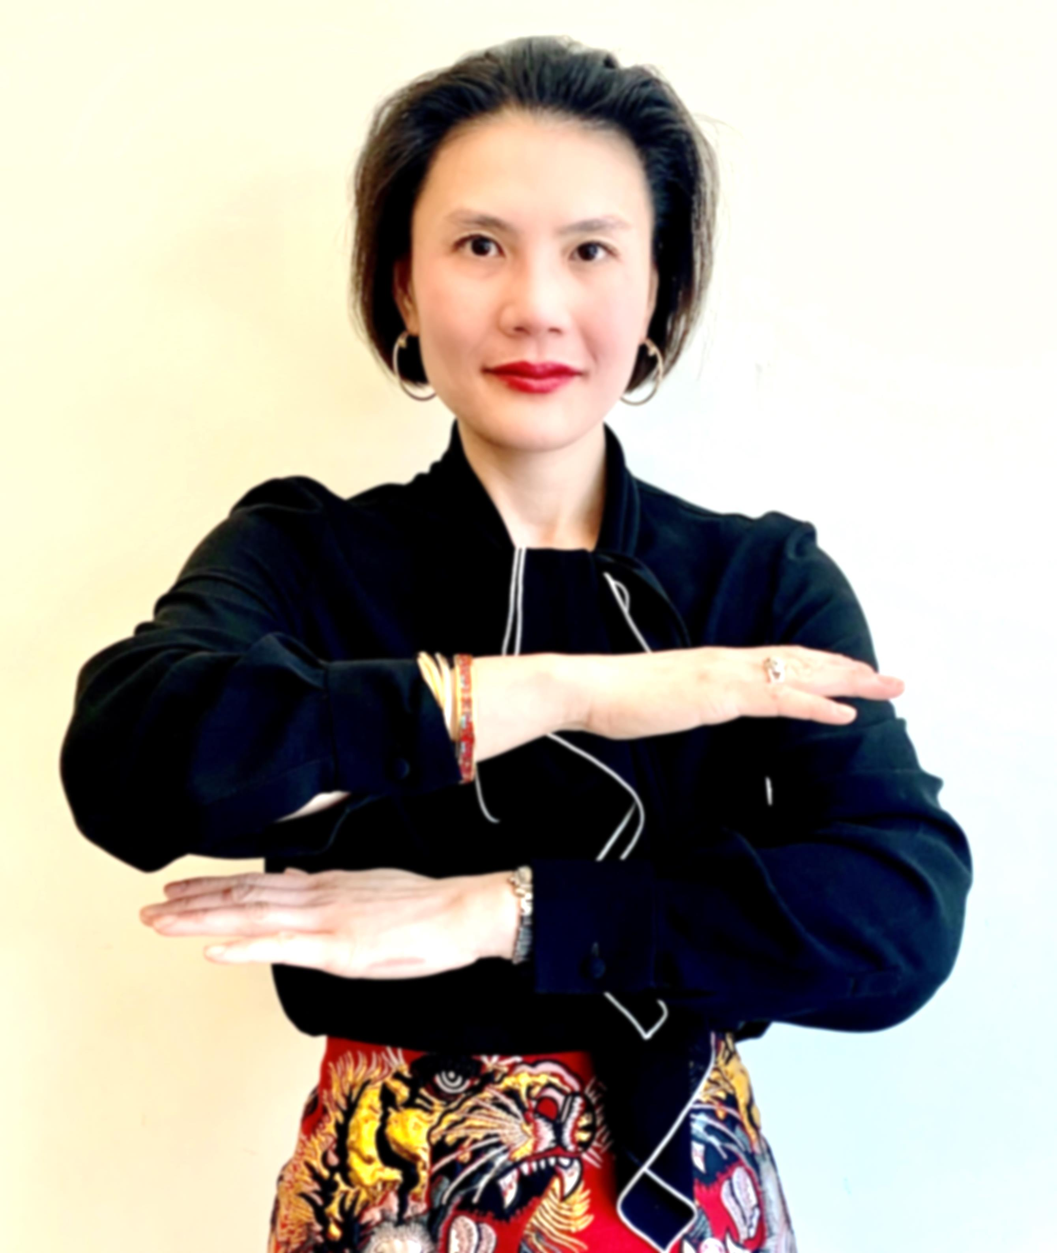
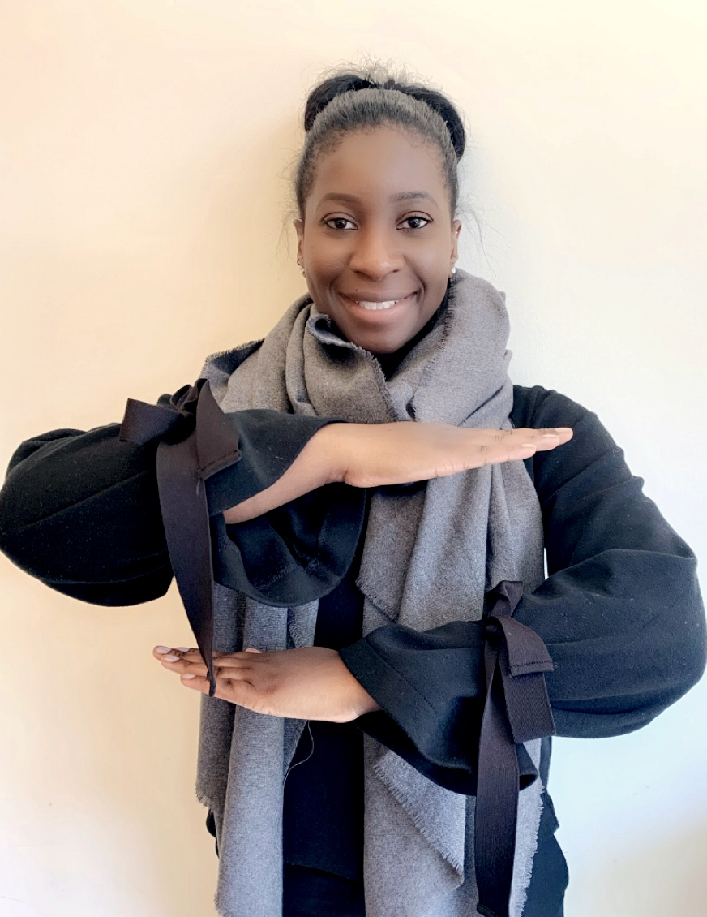
TALENT MANAGEMENT TEAM Alexandra Mai / Liz Clermont
Human Capital Planning
The Talent Management team will leverage this period in time to further refine and align our approach and practices around gender, diversity, and inclusion. We are committed to creating a work environment that values equality.
We aim to support the 2020 IWD theme of #EACHFOREQUAL across our portfolio by:
Facilitating a co-wide gender, diversity, and inclusion training.
Developing a robust digital strategy to further strengthen our recruitment brand.
Increase our recruitment efforts in the representation of women and minority legal professionals by 10%.
Launch a series of engagement activities.
On an intimate level, we will continue to raise our voice in advancing the conversation around gender equality, support women and girls, and empower the next generation through mentorship.

